Slide 1
Angular: Getting Started
Introduction

Slide 2


Slide 3

Angular Is …
A JavaScript framework
For building client-side applications Using HTML, CSS and TypeScript

Slide 4


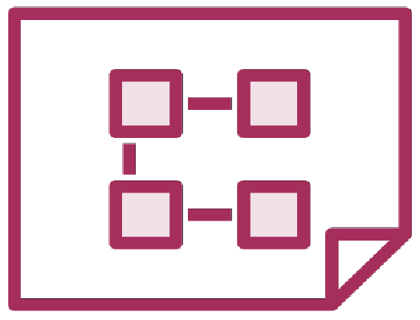

Why Angular?
Expressive HTML
Powerful Data Binding
Modular By Design
Built-in Back-End Integration

Slide 5

Module Overview
Anatomy of an Angular application
Getting the most from this course Sample application
Course outline

Slide 6
Anatomy of an Angular Application
Application
Component
Component
Component
…
=
+
+
Services

Slide 7


Component
Class
Component
=
Template
+
Properties
+
Metadata
Methods

Slide 8
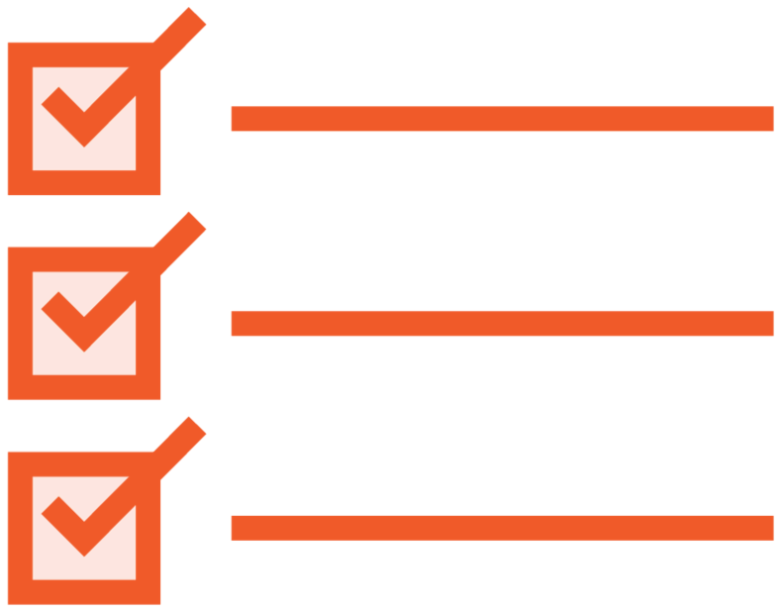


Prerequisites
Required
JavaScript basics
HTML basics
CSS basics
Helpful
Object-oriented programming (OOP) concepts
C++, C#, Java, …
Not required
Prior knowledge of Angular

Slide 9
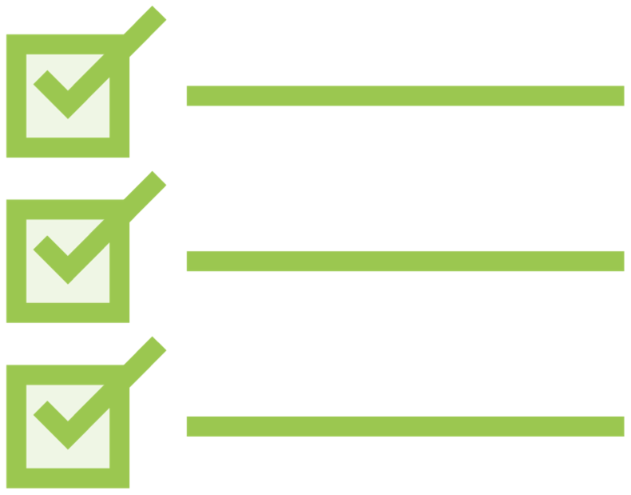
Checklist
Review module concepts
Code along assistance Revisit as you build

Slide 10

Coding Along
Code along with the demos throughout this course
Helpful for practicing what you learn You'll have a working sample application

Slide 11

Demo
Sample application

Slide 12
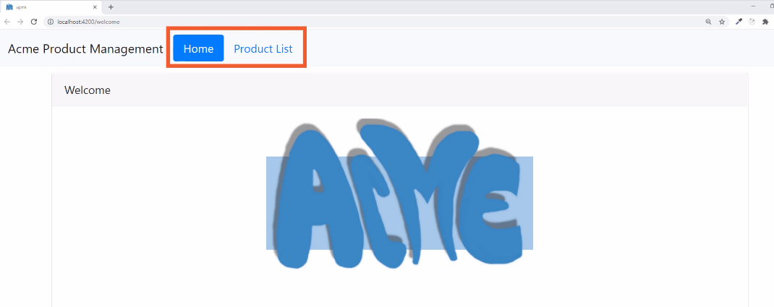

Slide 13
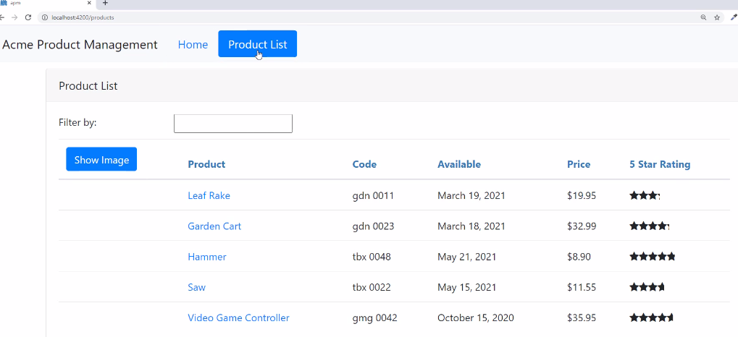

Slide 14
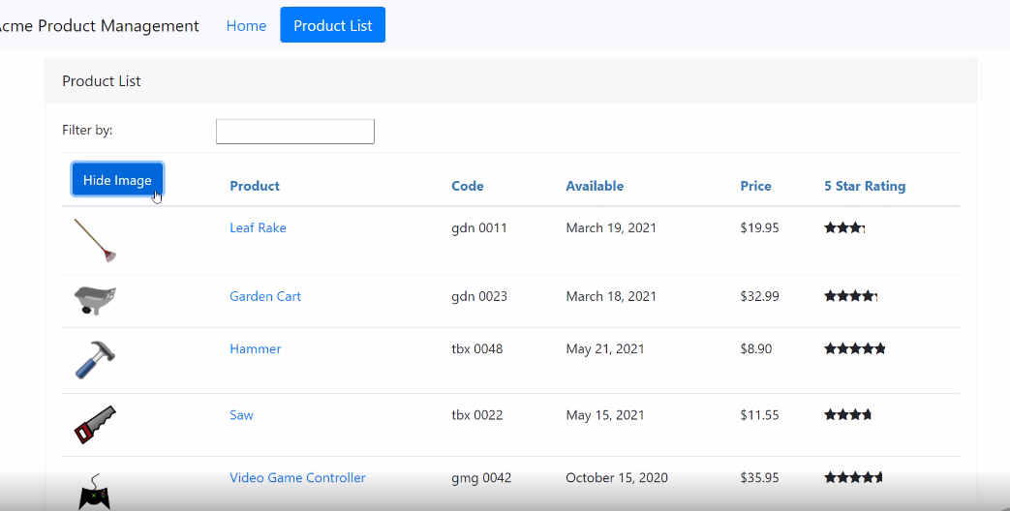

Slide 15
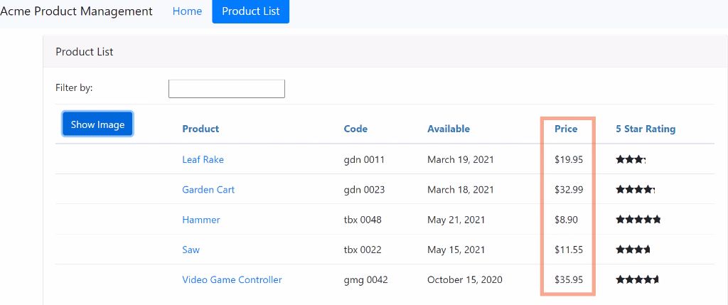

Slide 16
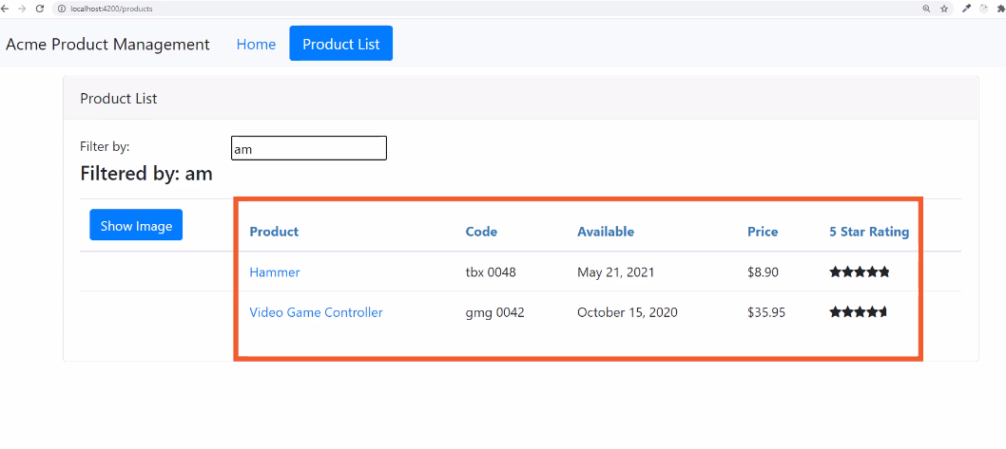

Slide 17
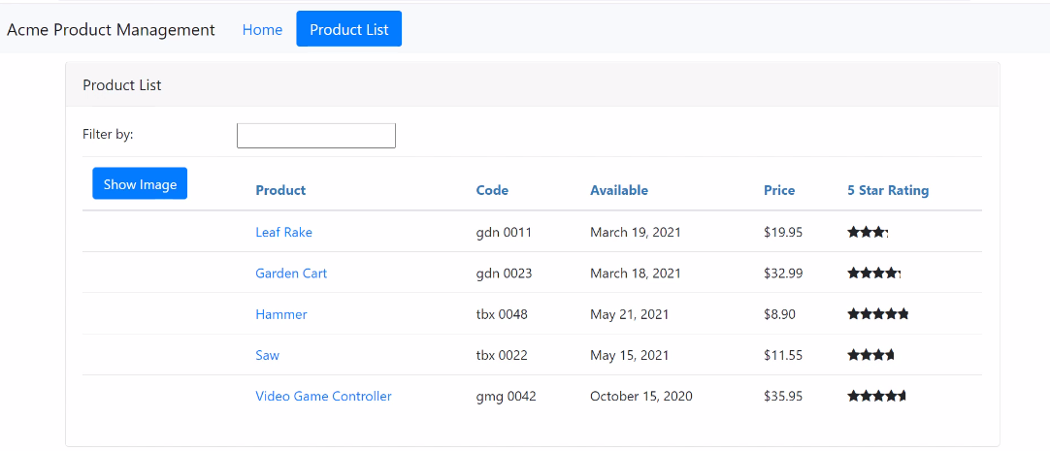

Slide 18
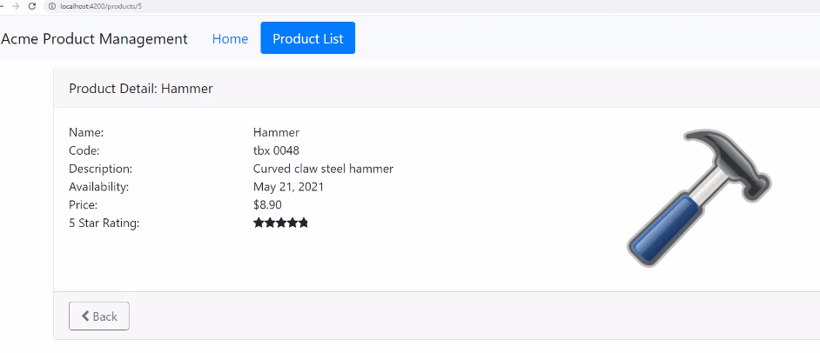

Slide 19
Sample Application Architecture
Welcome Component
index.html
App Component
Product List Component
Star Component
Product Detail Component
Product Data Service

Slide 20
First Things First Introduction to Components
Templates, Interpolation, and Directives Data Binding & Pipes
More on Components Building Nested Components
Services and Dependency Injection Retrieving Data Using HTTP
Navigation and Routing Angular Modules
Building, Testing and Deploying with the CLI
Course Outline

Slide 21
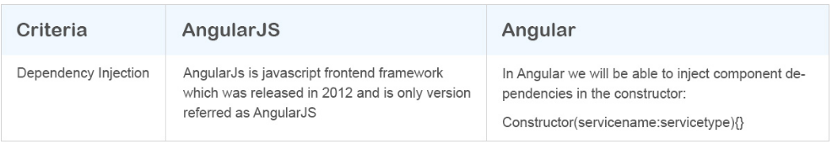
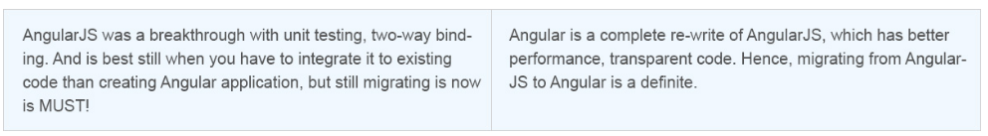
Dependency Injection

Slide 22
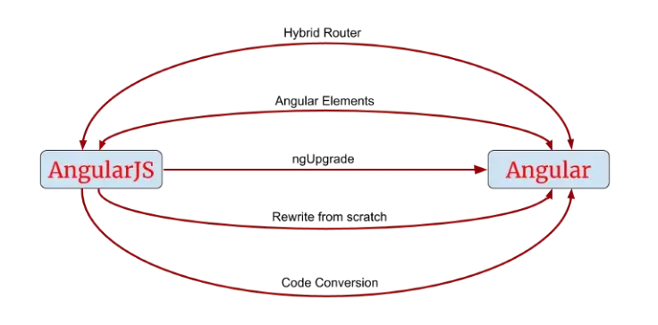
AngularJS to Angular Migrations

Slide 23
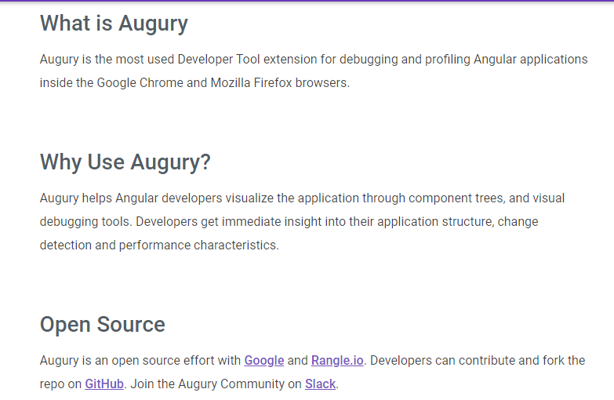
Working with Augury
Reference: https://augury.rangle.io/pages/guides/index.html,
https://chrome-stats.com/d/elgalmkoelokbchhkhacckoklkejnhcd/download

Slide 24
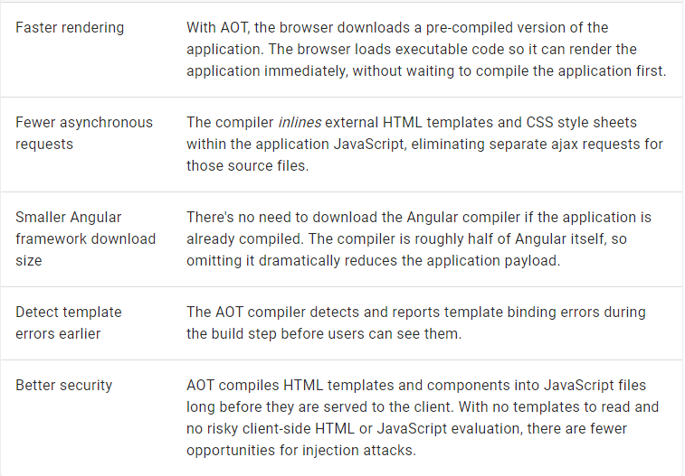
AOT Benefits

Slide 25

Coming up next …
First Things First

